Slide 1

Total United States Vehicle Sales Forecast Analysis
Comparing Multiple Forecast Methods
Fernando Zambrano
Dr. Reza Jafari
The George Washington University

Slide 2

Overview
Goal
Data Description
Data Inspection
Models
Model Selection
Conclusion

Slide 3
Goal
Derive an accurate model to forecast monthly US vehicle sales
Compare 3 sophisticated models
Choose the best model
Why?
Auto industry accounts for:
10 million jobs across 44 states
6% of US GDP

Slide 4
Data Description
The data is from the Federal Reserve Economic Data (FRED) database.
Includes eight different variables observed from 1976 to 2020.
Total of 529 records (4,232 observations)
Split data into Train (439) and Test (106) data sets
Dependent variable is vehicle unit sales in millions
The other 7 features are tied to the auto industry or measurements of US economic status.

Slide 5
Independent Features
CPI for All Urban Consumers
CPI for All Urban Consumers Less Food and Energy,
CPI for Used Cars and Trucks for All Urban Consumers
CPI for New Cars and Trucks for All Urban Consumers
Total Number of Employees on Payroll Not Including Farming in thousands
US Unemployment Rate as a percent,
Capacity Utilization for Automobile and Motor Vehicles as a percent of capacity.

Slide 6

Data Inspection

Slide 7

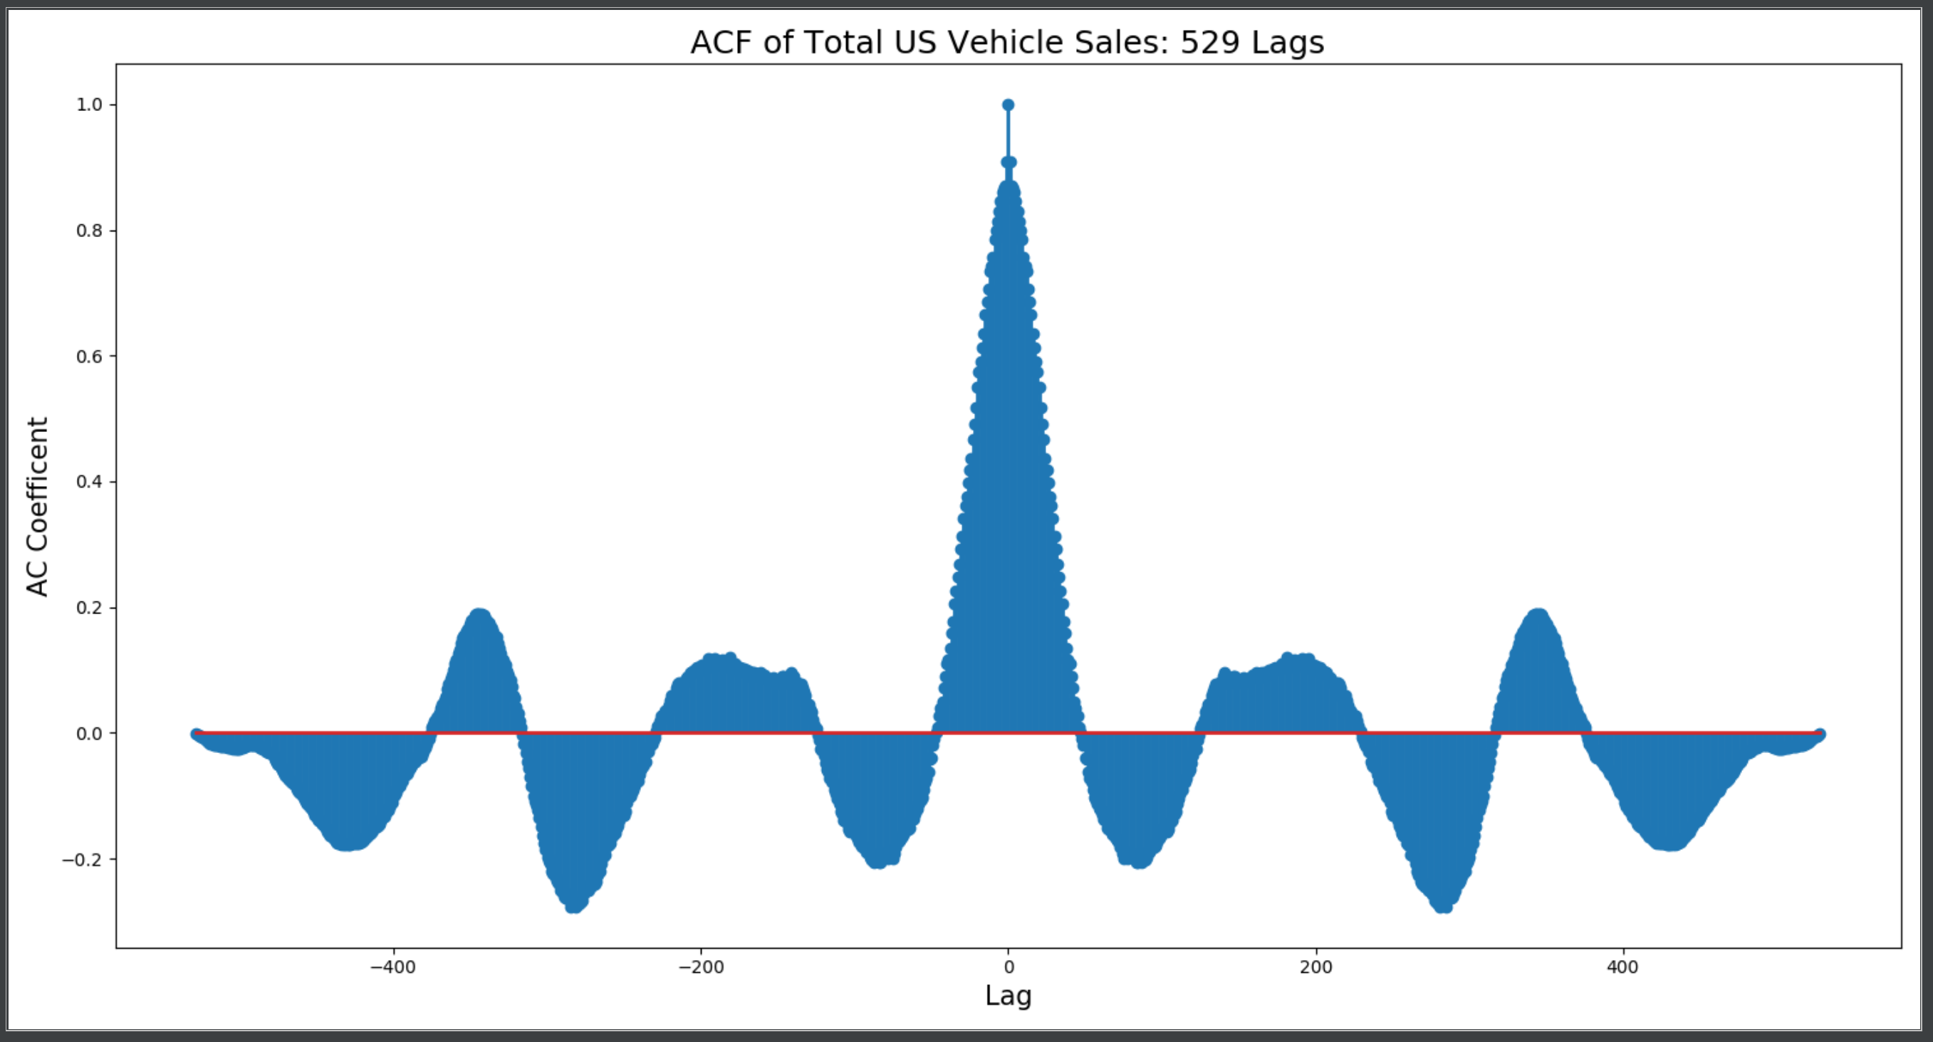
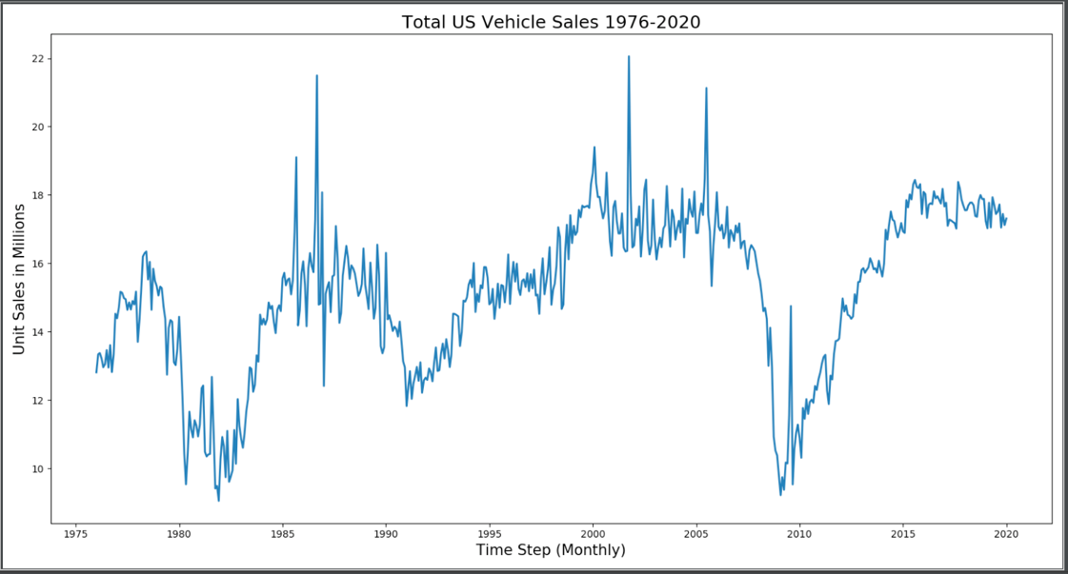
Data Inspection
Trend and Cyclical
Inconsistent periods
High variance

Slide 8
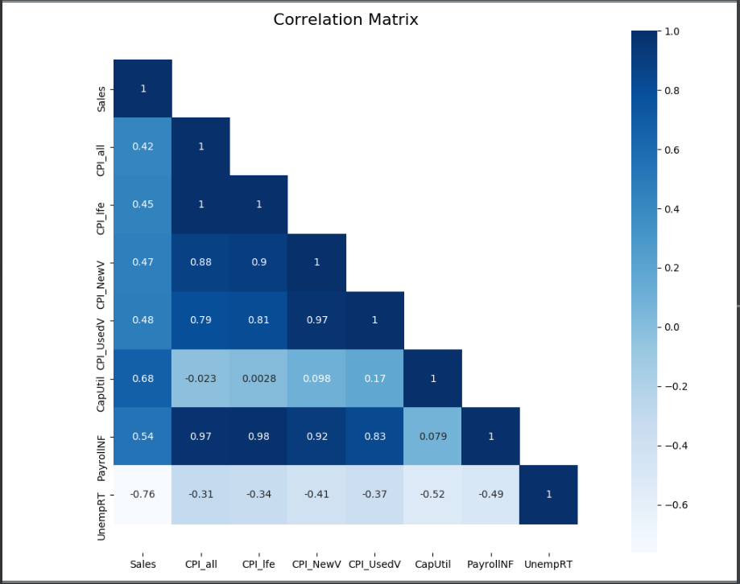
Data Inspection
All CPI features are not highly correlated with sales
CPI features and payroll exhibit multicollinearity
Some of these features will dropped in feature selection
Capacity utilization and unemployment rate show strong correlation with sales

Slide 9
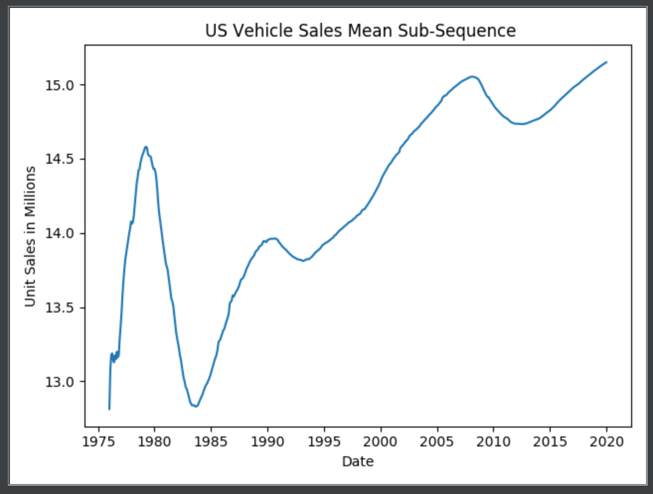
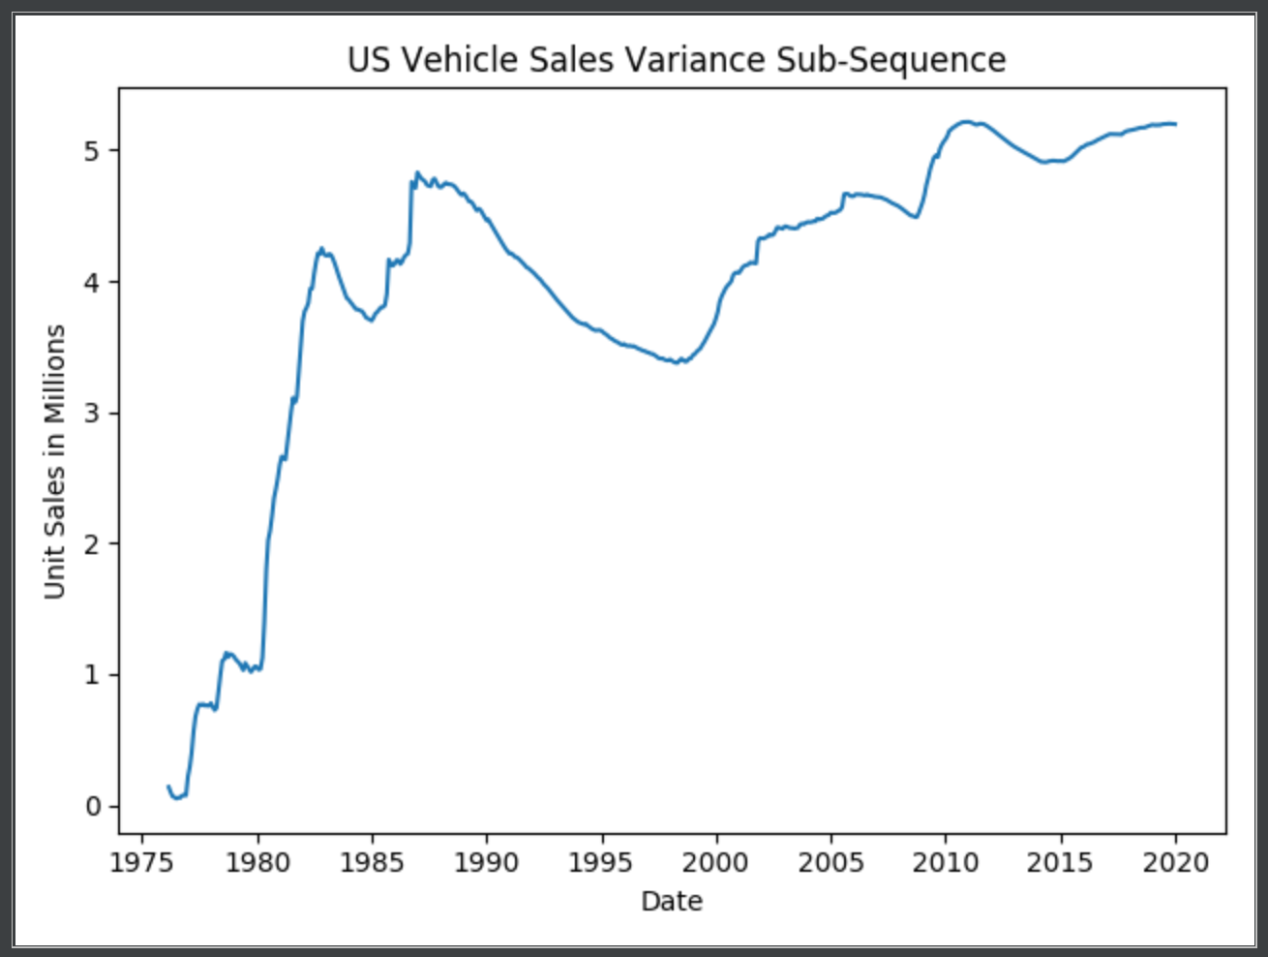
Stationarity
ADF TEST: US Vehicle Sales
ADF Statistic: -2.050952
p-value: 0.264689
Critical Values:
1%: -3.442891
5%: -2.867072
10%: -2.569716

Slide 10
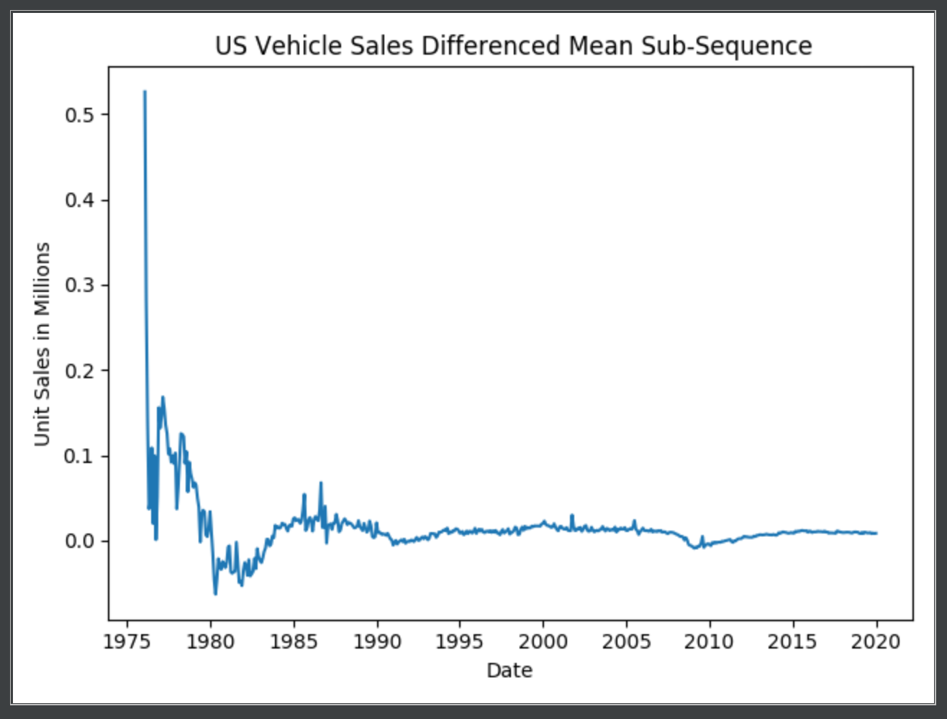
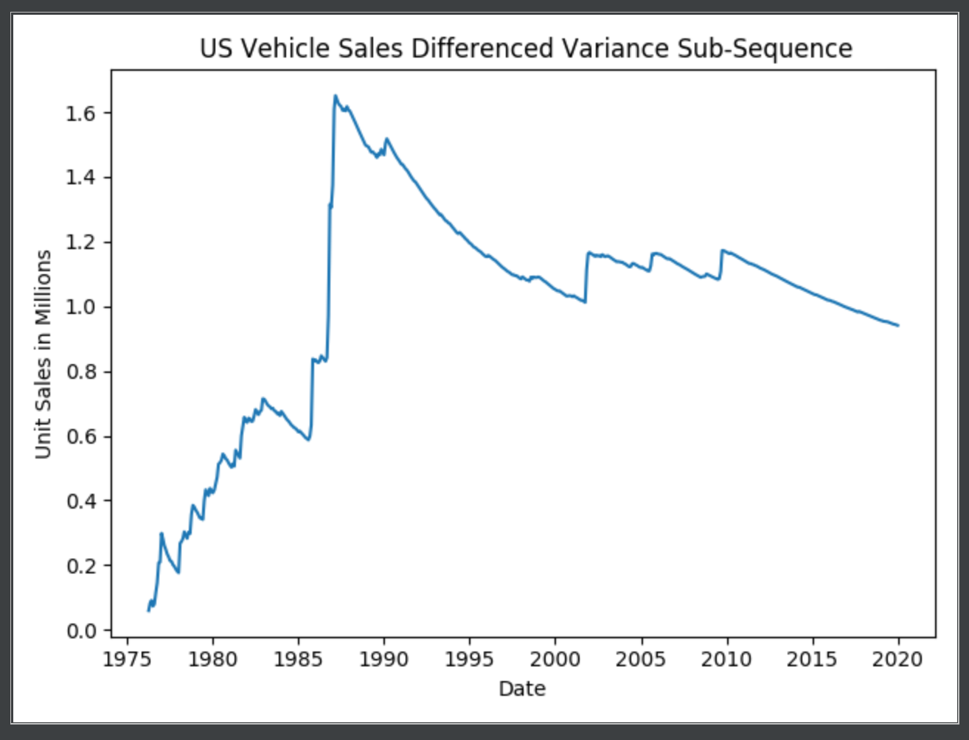
Stationarity - Differenced
ADF TEST: US Vehicle Sales (Differenced)
ADF Statistic: -16.818233
p-value: 0.000000
Critical Values:
1%: -3.442891
5%: -2.867072
10%: -2.569716

Slide 11
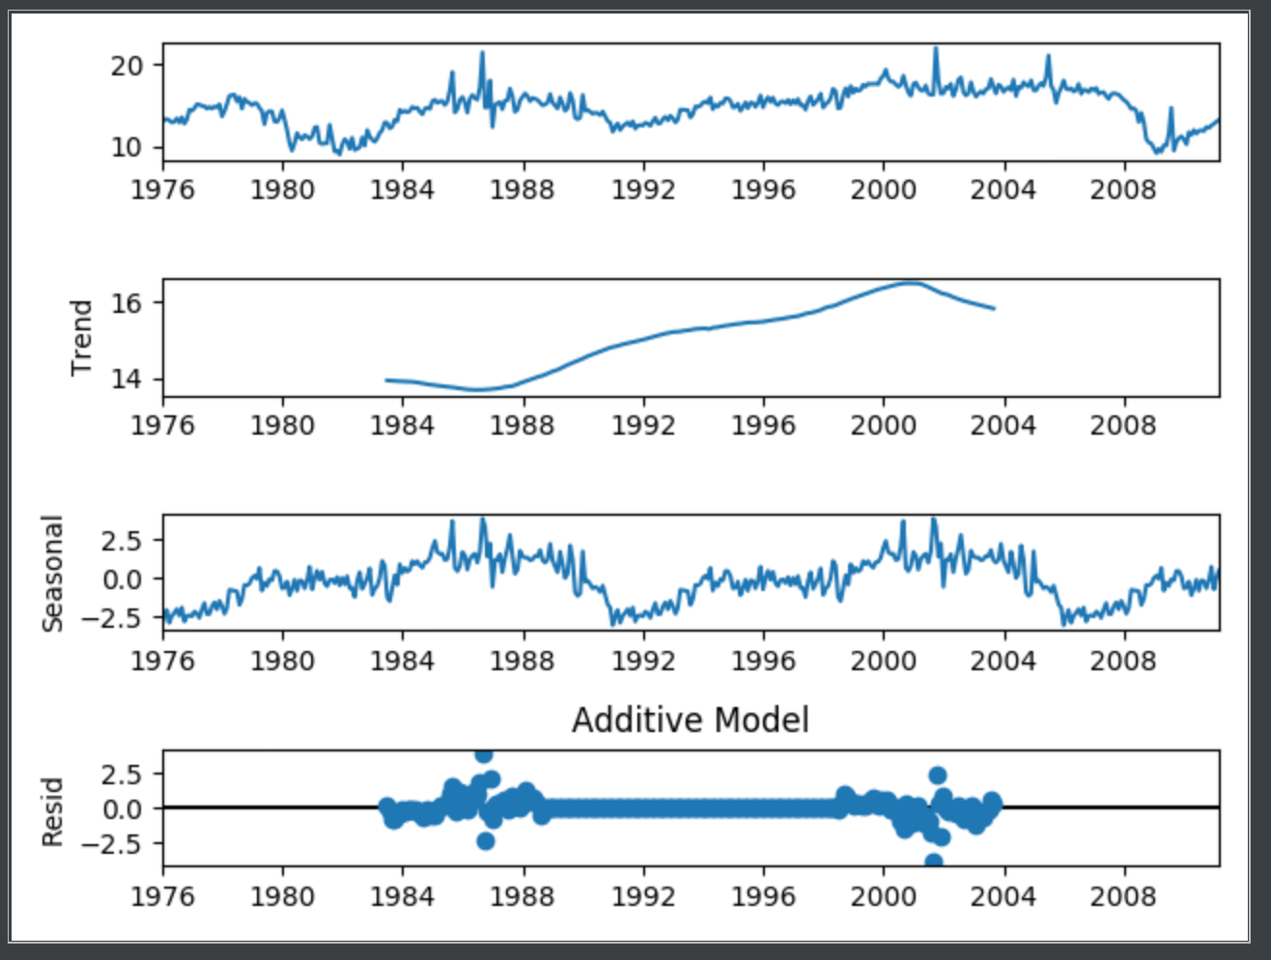
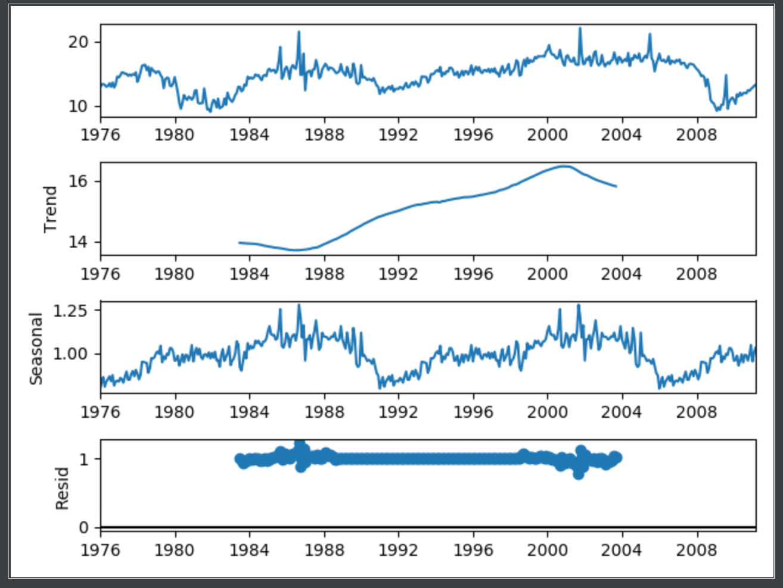
Decomposition
Additive Multiplicative

Slide 12
Models

Slide 13
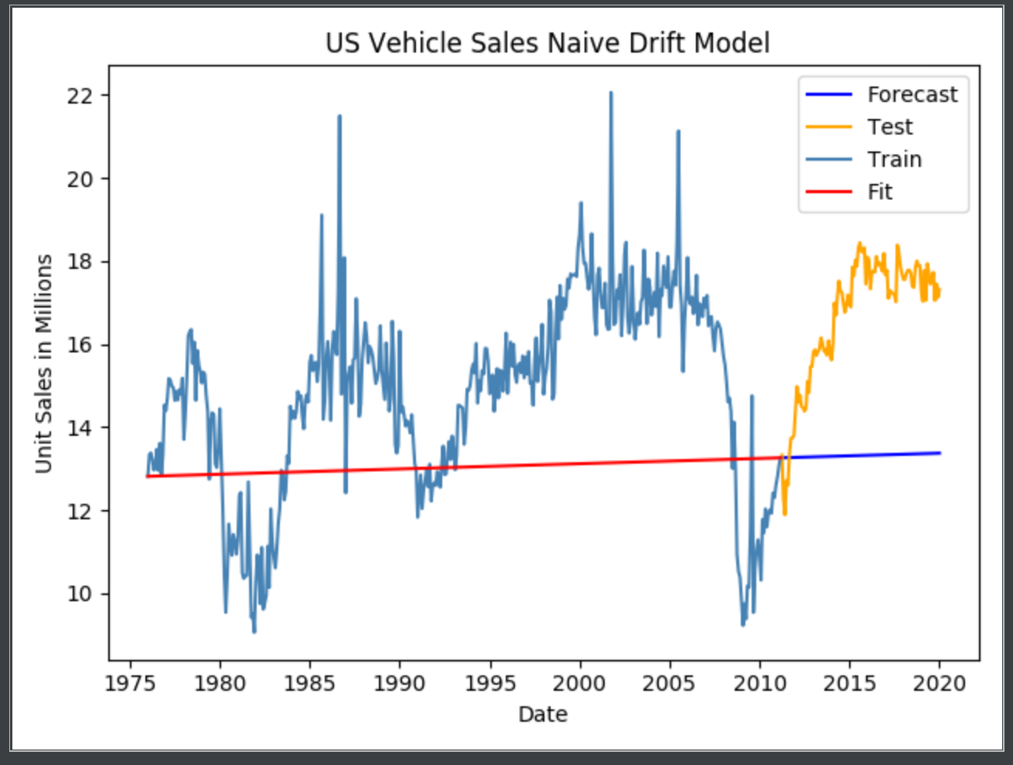
Baseline Model – Naïve Drift
Takes the slope of the line between the first and last observation in the training set.
The drift line then forecasts using the that slope for h number of observations in the test set.
Naïve Drift | Residual | Forecast
SEE | 3398.41 | 1423.20
MSE | 8.03 | 13.42
RMSE | 2.834 | 3.664
VAR | 5.034 | 2.264

Slide 14
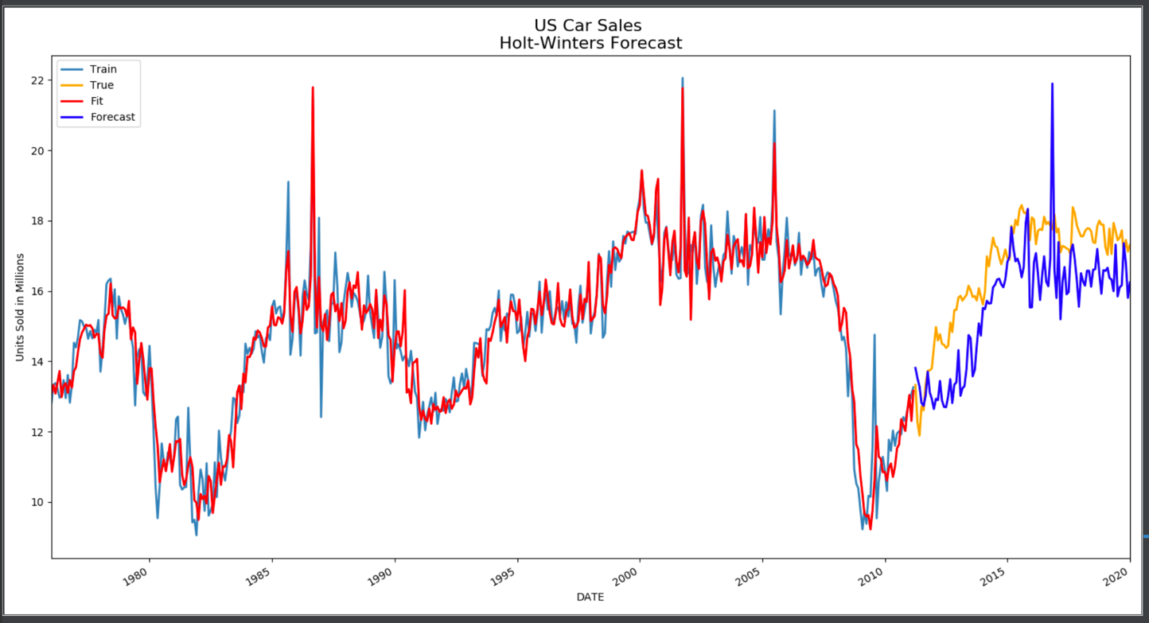
Holt-Winters (HW)
Can handle trended and seasonal data (non-stationary data)
Uses four equations:
Forecast
3 Smoothing:
Level
Trend
Seasonal
Holt-Winters | Residual | Forecast
SEE | 191.95 | 216.18
MSE | 0.45 | 2.04
ME | -0.003 | 1.091
RMSE | 0.671 | 1.428
VAR | 0.455 | 0.857
Parameter | Value
Alpha | 0.450
Beta | 0.028
Phi | 0.933
Gamma | 0.000
L_0 | 62.467
B_0 | 0.964

Slide 15
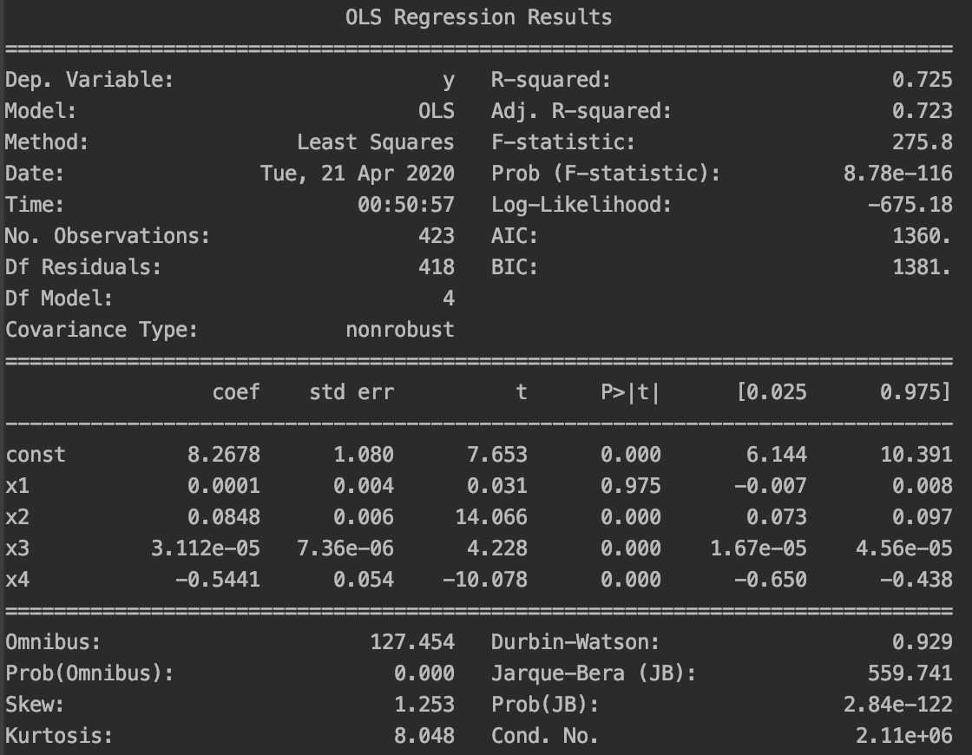
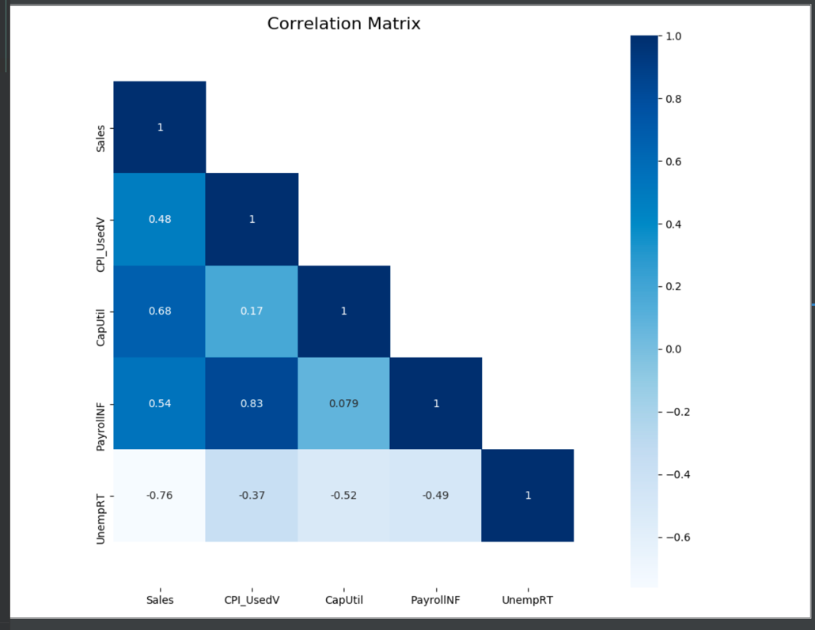
Linear Regression (OLS) – Feature Selection

Slide 16
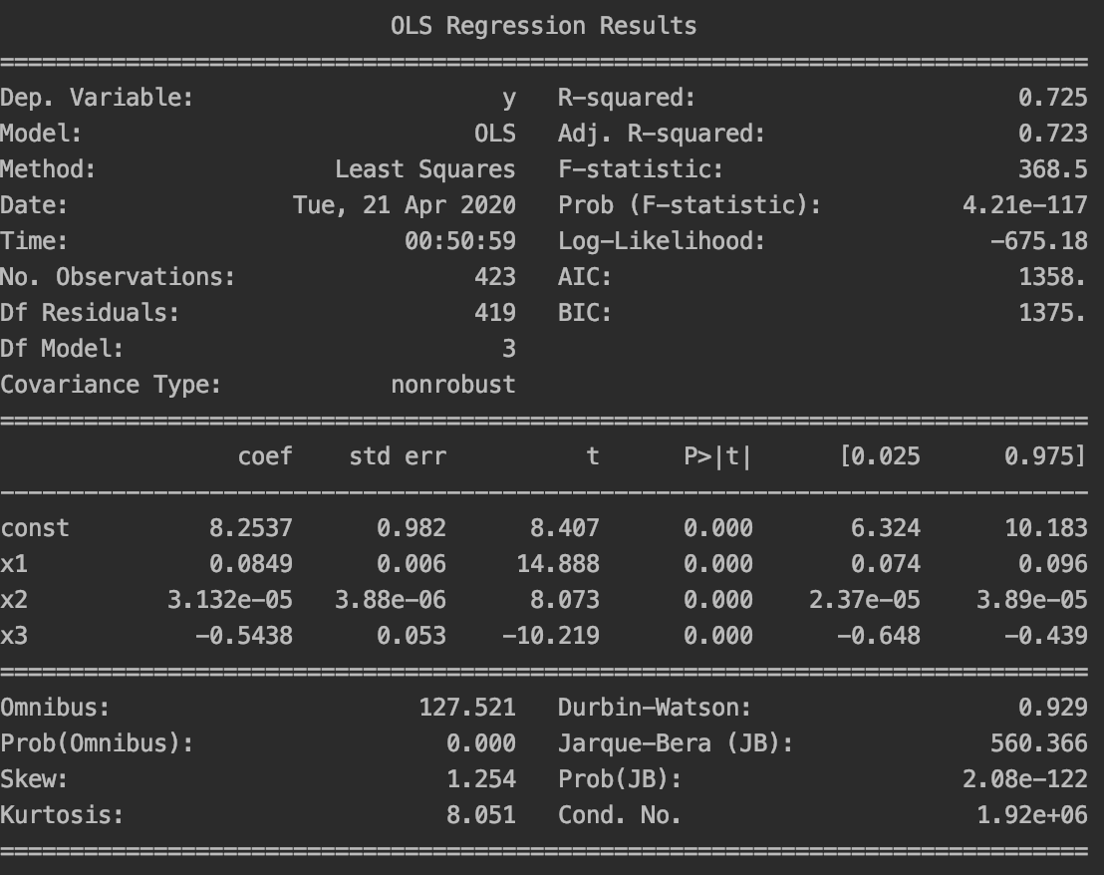
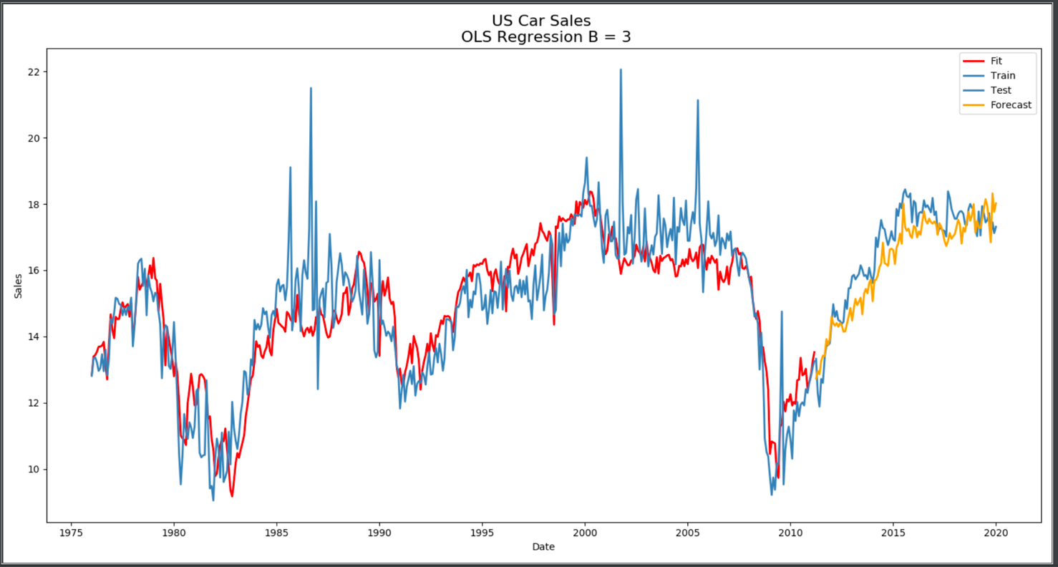
Linear Regression (OLS) – Best Model
Features:
X1: Capacity Utilization
X2: Payroll
X3: Unemployment Rate
OLS | Residual | Forecast
SEE | 602.95 | 45.51
MSE | 1.43 | 0.43
ME | 3.987396e-13 | 0.39
RMSE | 1.19 | 0.66
VAR | 1.43 | 0.27
Q | 2537.160 | None

Slide 17
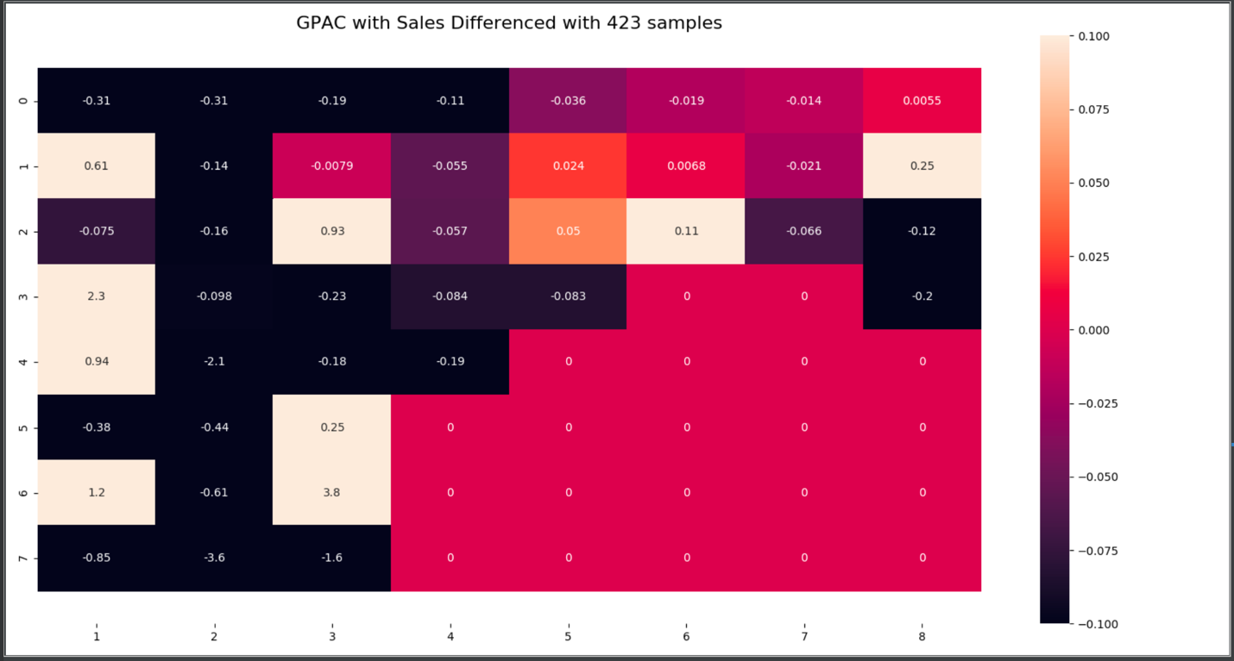
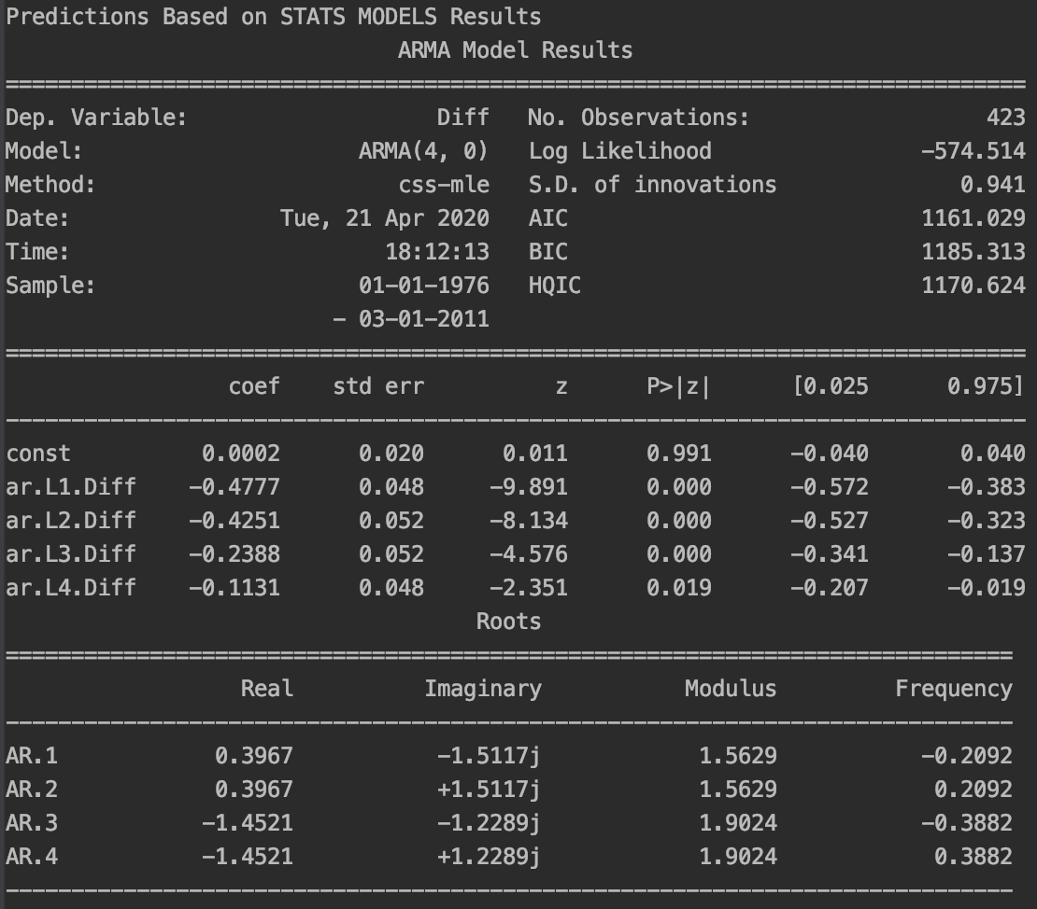
ARMA (4,0) – GPAC & Parameter Estimation

Slide 18
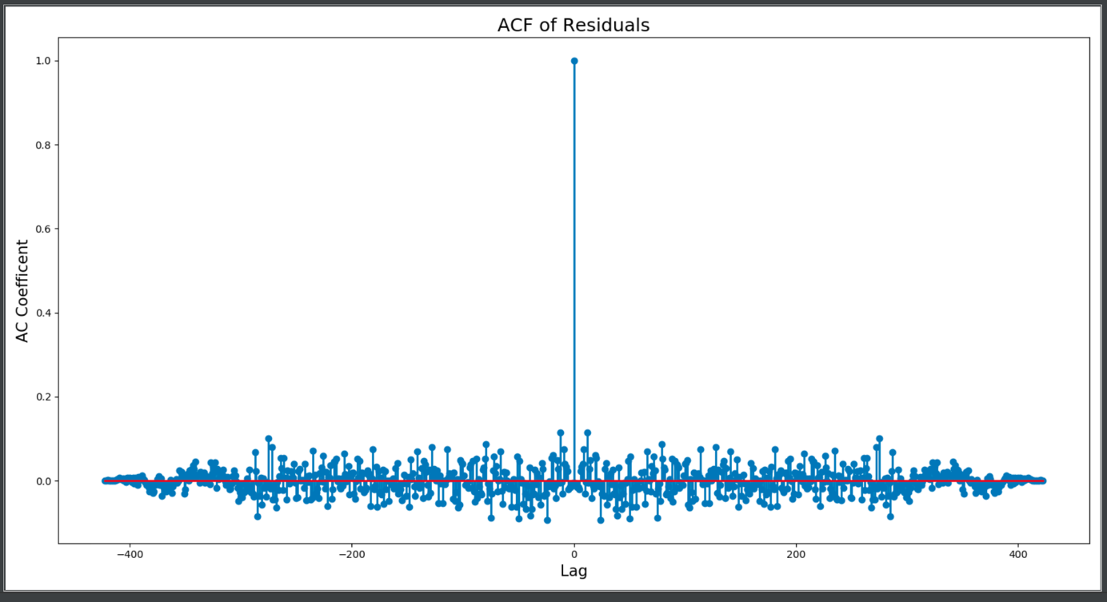
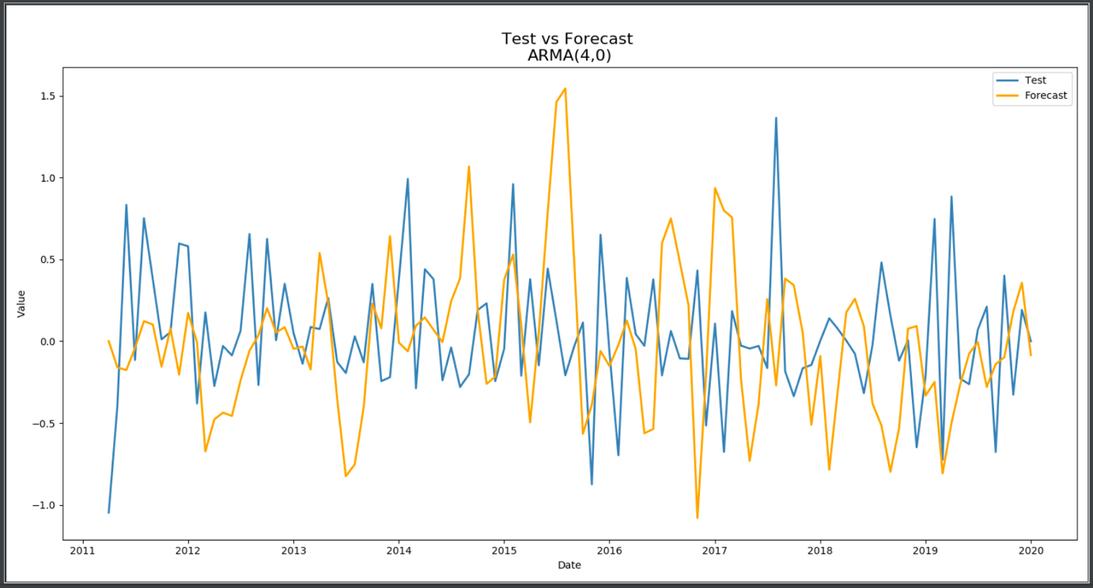
ARMA (4,0) – Stationary Results
ARMA (4,0) | Residuals | Forecast
ME: | 0.001 | 0.054
SSE: | 374.271 | 41.049
MSE: | 0.885 | 0.387
RMSE: | 0.032 | 0.231
Variance of Error: | 0.885 | 0.384
Q: | 176.255 < CHI Critical: 489.269 | None
Residuals are white | YES | None

Slide 19
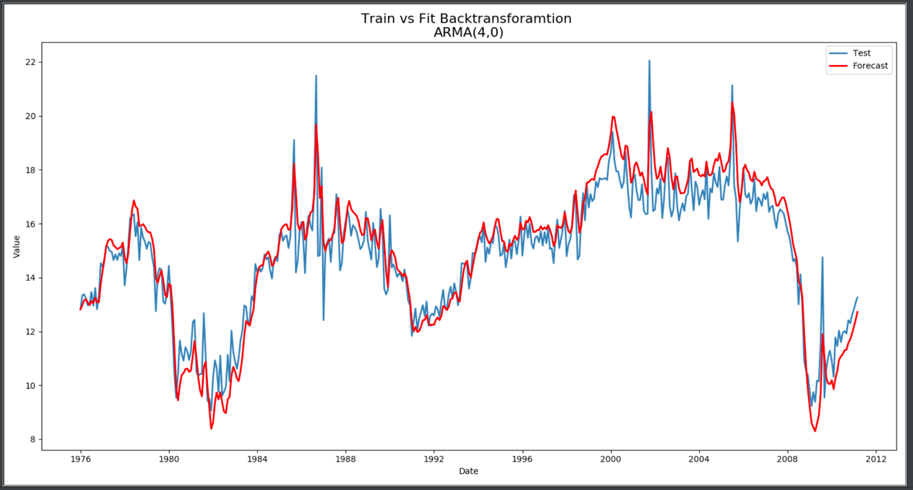
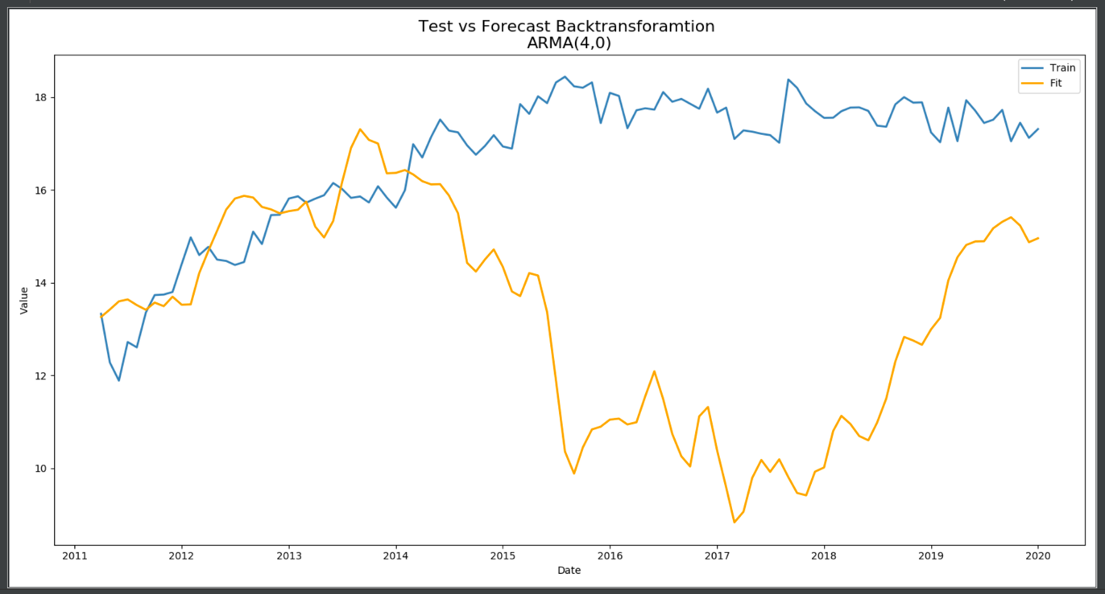
ARMA (4,0) – Reverse Transformation Results
ARMA (4,0) RT | Residuals | Forecast
ME: | -0.213 | 3.382
SSE: | 288.688 | 2362.548
MSE: | 0.682 | 22.288
Variance of Error: | 0.637 | 10.847
Q | 1595.088 > CHI-Critical: 603.310 | None
Residuals White | NO | None

Slide 20
Model Selection

Slide 21
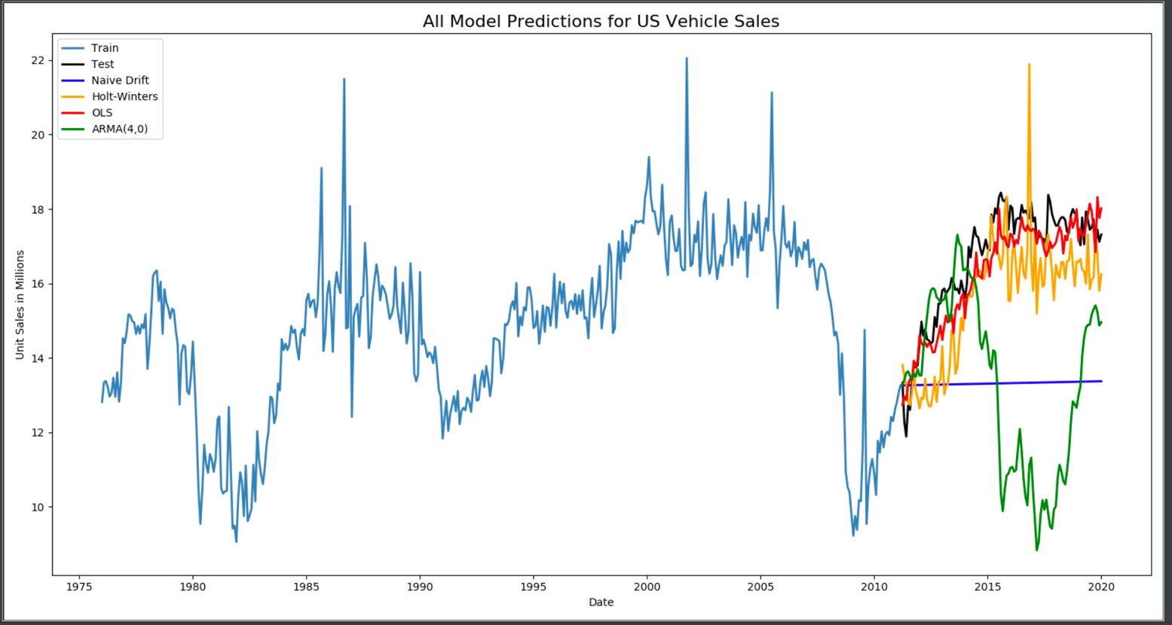
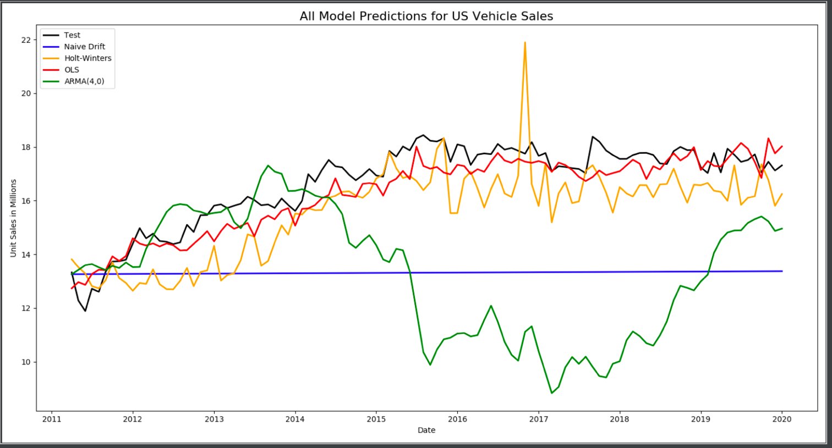
Model & Forecast Result Comparison
Naïve Drift | Residual | Forecast
SEE | 3398.41 | 1423.20
MSE | 8.03 | 13.42
RMSE | 2.834 | 3.66
ARMA (4,0) RT | Residual | Forecast
SSE: | 288.688 | 2362.548
MSE: | 0.682 | 22.288
RMSE | 0.825 | 4.721
Holt-Winters | Residual | Forecast
SEE | 191.95 | 216.18
MSE | 0.45 | 2.04
RMSE | 0.671 | 1.428
OLS | Residual | Forecast
SEE | 602.95 | 45.51
MSE | 1.43 | 0.43
RMSE | 1.19 | 0.66

Slide 22
Conclusion
The OLS model had the best forecasting error metrics in RMSE, MSE, and SSE
ARMA predictions were grossly under forecasted
ARMA model was less successful than the baseline drift model
The HW model had better residual errors than OLS
HW model consistently underestimated more than OLS
OLS fitted models cut through cyclical peaks
OLS model will have trouble forecasting further steps beyond the test set
“SES with a drift” method may perform well

Slide 23
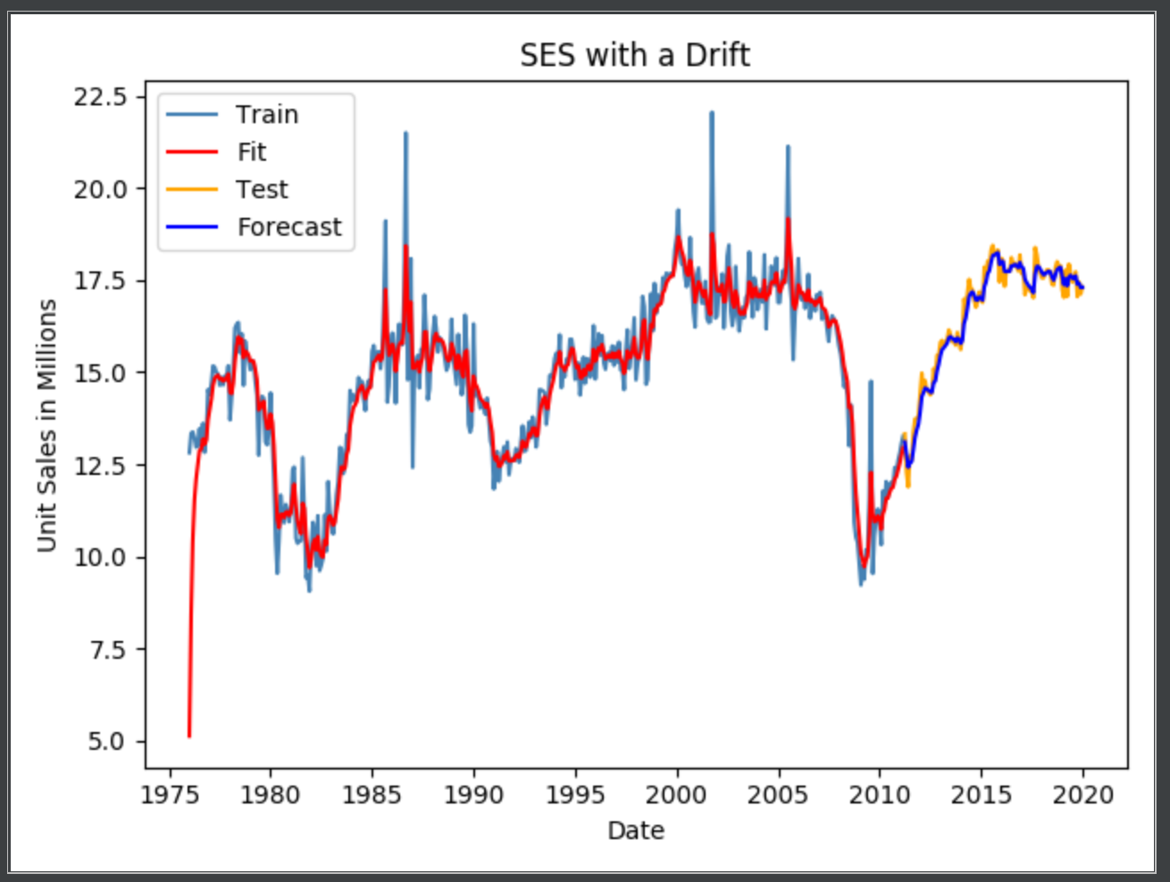
Extra
Holt-Liner Trend (SES-Drift) | Error | OLS
SSE | 6.723 | 45.51
ME | 0.062 | 0.39
MSE | 0.063 | 0.43
RMSE | 0.252 | 0.66
VAR | 0.060 | 0.27

Slide 24
Sources
Alliance of Automobile Manufactures; https://autoalliance.org/in-your-state. April 20, 2020.
U.S. Bureau of Economic Analysis, Total Vehicle Sales [TOTALSA], retrieved from FRED, Federal Reserve Bank of St. Louis; https://fred.stlouisfed.org/series/TOTALSA, February 25, 2020.
U.S. Bureau of Labor Statistics, Consumer Price Index for All Urban Consumers: All Items in U.S. City Average [CPIAUCSL], retrieved from FRED, Federal Reserve Bank of St. Louis; https://fred.stlouisfed.org/series/CPIAUCSL, February 27, 2020.
U.S. Bureau of Labor Statistics, Consumer Price Index for All Urban Consumers: All Items Less Food and Energy in U.S. City Average [CPILFESL], retrieved from FRED, Federal Reserve Bank of St. Louis; https://fred.stlouisfed.org/series/CPILFESL, February 27, 2020.
U.S. Bureau of Labor Statistics, Consumer Price Index for All Urban Consumers: Used Cars and Trucks in U.S. City Average [CUSR0000SETA02], retrieved from FRED, Federal Reserve Bank of St. Louis; https://fred.stlouisfed.org/series/CUSR0000SETA02, February 27, 2020.
U.S. Bureau of Labor Statistics, All Employees, Total Nonfarm [PAYEMS], retrieved from FRED, Federal Reserve Bank of St. Louis; https://fred.stlouisfed.org/series/PAYEMS, February 27, 2020.
U.S. Bureau of Labor Statistics, Unemployment Rate [UNRATE], retrieved from FRED, Federal Reserve Bank of St. Louis; https://fred.stlouisfed.org/series/UNRATE, February 27, 2020.
Board of Governors of the Federal Reserve System (US), Capacity Utilization: Durable Manufacturing: Automobile and light duty motor vehicle [CAPUTLG33611S], retrieved from FRED, Federal Reserve Bank of St. Louis; https://fred.stlouisfed.org/series/CAPUTLG33611S, February 27, 2020

